Slide 1
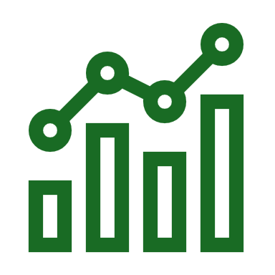
Evaluation & Prediction of Ecommerce Sales

Slide 2

Introduction
Sales analysis involves examining sales data to uncover patterns, trends, and insights that can inform business decisions. It's a crucial aspect of understanding how well products or services are performing in the market and identifying areas for improvement.
Process enables companies to identify strengths, weaknesses, opportunities, and threats, guiding strategic initiatives aimed at improving sales efficiency, maximizing revenue, and achieving long-term growth objectives. Through effective sales analysis, organizations can adapt swiftly to market changes, optimize resource allocation, and enhance overall competitiveness.
The process of sales analysis typically includes gathering and organizing data from various sources such as sales reports, customer databases, and transaction records.

Slide 3
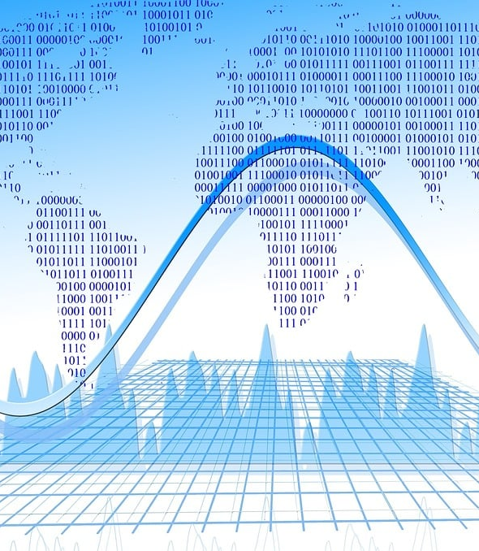
Problem Statement:
Sales data is currently scattered across various sources, making it difficult to gain a comprehensive and timely understanding of sales performance. This lack of readily available insights hinders our ability to:
Track key performance indicators (KPIs) effectively: This includes monitoring overall sales trends, identifying top-performing products and regions, and measuring progress against sales goals.
Proactively identify areas needing improvement: Without clear and accessible data, it's challenging to pinpoint factors impacting sales, such as underperforming products, ineffective marketing campaigns, or underutilized sales channels.
Make data-driven decisions for optimized sales strategies: Without insights readily available, decision-making around resource allocation, product development, and marketing efforts might be based on incomplete information or intuition, rather than concrete data.

Slide 4

OBJECTIVE
To contribute to the success of a business by utilizing data analysis techniques , specifically focusing on time series analysis, to provide valuable insights and accurate sale forecasting
Sales Performance
Product Performance
Market Trends
Customer Insights
Sales Channel
Forecasting
Performance Metrics

Slide 5
PROPOSED SOLUTION
Developing a comprehensive sales dashboard will provide a centralized platform for visualizing and analyzing key sales metrics. This interactive dashboard will:
Consolidate data from various sources, including sales figures, product information, customer details, and historical trends.
Offer insights into sales performance, enabling quick identification of strengths, weaknesses, and areas for improvement.
Facilitate data exploration through interactive visualizations like charts, graphs, and maps, allowing users to drill down into specific details and gain deeper understanding.
Empower sales managers and other stakeholders to make data-driven decisions and optimize sales strategies for increased revenue, profitability, and customer satisfaction.
This solution aims to transform the way sales data is accessed, analyzed, and utilized, leading to improved efficiency, informed decision-making, and ultimately, enhanced sales performance

Slide 6
DESCRIPTION
The objective can be broken into the following detailed component :
Dashboard Creation: Identify the KPIs, design an interative and visually appealing , dashboard, add interactive visualization and filtering capabilities to allow user to explore the data at various level of granularity.
Data Analysis: provide valuable insight to business entities regarding the effectiveness of their sales strategies through visualization and chart.
Sales Forecasting: leverage historic data and apply time series analysis to generate sales forecast for past years.
Future Prediction: Used to predict the sales for upcoming days to make future plans according to the prediction.
Data Evaluation: Evaluating the data based on specifications and requirements.

Slide 7
INSIGHTS
Here are some potential insights for the conclusion of your project on store sales data:
1. Key Performance Indicators (KPIs): Summarize the main findings based on the chosen KPIs like total sales, profit margin, average order value, customer acquisition cost, etc.
2. Trends and Seasonality: Highlight any identified trends within the data, such as seasonal fluctuations, growth patterns, or correlations between variables.
3. Top Performers and Areas for Improvement: Identify top-performing stores, products, or customer segments, and areas where sales can be improved based on the analysis.
4. Actionable Recommendations: Based on the insights, suggest specific actions that can be taken to improve sales performance, such as targeted promotions, inventory optimization, or store layout adjustments.
5. Future Analysis: Mention potential areas for further exploration and potential limitations of the current analysis. This could include analyzing customer demographics, sentiment analysis from social media, or incorporating external data sources.

Slide 8
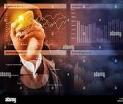
Conclusion
In conclusion, sales analysis serves as a cornerstone of strategic decision-making for businesses, offering invaluable insights into market trends, customer preferences, and overall sales performance. By leveraging data-driven approaches to assess key metrics and performance indicators, organizations can not only identify areas of strength but also pinpoint opportunities for improvement.
This proactive approach enables businesses to optimize marketing strategies, refine product offerings, and allocate resources more effectively, ultimately driving profitability and sustainable growth.
As businesses navigate the complexities of today's competitive landscape, the importance of data-driven insights cannot be overstated. Sales analysis provides the framework and tools necessary for businesses to thrive, innovate, and achieve sustainable growth.

Slide 9
Future Scope
Data Integration and Management: Python's versatility in handling data from various sources (databases, APIs, spreadsheets, etc.) makes it ideal for integrating and managing large datasets. Future advancements may include enhanced tools and libraries for seamless data integration and preprocessing.
Advanced Analytics and Machine Learning: Python's robust libraries (such as Pandas, NumPy, Scikit-learn, TensorFlow, and PyTorch) facilitate advanced analytics, predictive modeling, and machine learning applications in sales analysis. Future developments may focus on more sophisticated algorithms for sales forecasting, customer segmentation, and personalized marketing.
Visualization and Dashboarding: Python's libraries like Matplotlib, Seaborn, Plotly, and Dash enable interactive data visualization and the creation of insightful dashboards. The future may see advancements in real-time visualization capabilities and integration with business intelligence (BI) tools for better decision-making.

Slide 10

Automation and Efficiency: Python is widely used for automating repetitive tasks in data processing, reporting, and analysis workflows. Future advancements may include more intelligent automation through AI-driven insights and automated anomaly detection in sales data.
Cloud Computing and Scalability: Python's compatibility with cloud platforms (AWS, Google Cloud, Azure) facilitates scalable and cost-effective solutions for handling large volumes of sales data. Future trends may involve serverless computing, containerization (e.g., Docker), and improved cloud-native analytics frameworks

Slide 11
THANK YOU!!
Made by:
DHRUVIL SHAH (2101201044)
SHUBH PATEL (2101201165)

